Slide 1
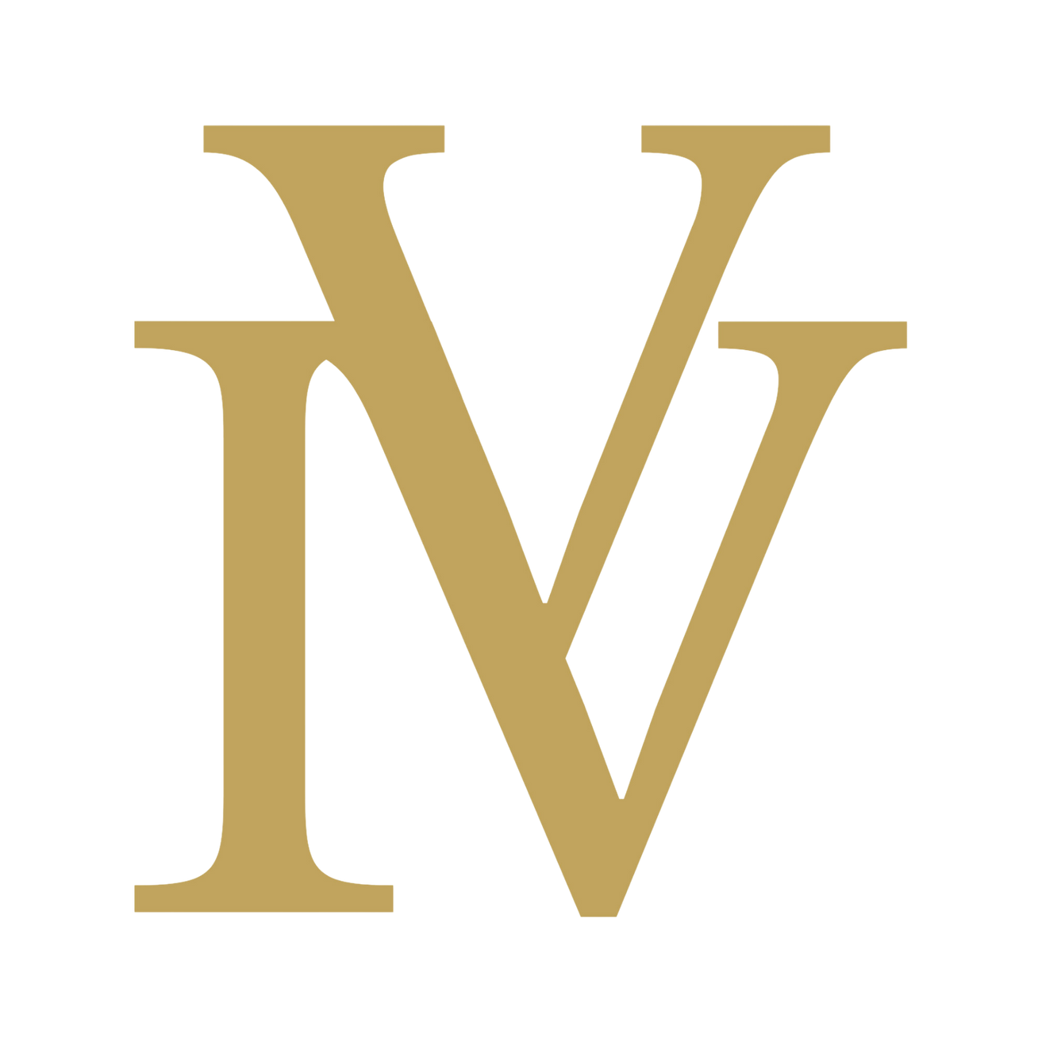
Innovest
Capital
Rebranding

Slide 2
COLOURS

Slide 3
logo colours

Slide 4
main corporate colours
091B2A
0A1F44
C1A45D
E0CFAB

Slide 5
secondary colours
F7F5EF
6A9C8F
8A7A63
CC7A61

Slide 6
Main Corporate Colour
Secondary Colour
Light Background
Supportive Colour
colour
palette
091B2A
0A1F44
F7F5EF
6A9C8F
Main Premium Colour
Secondary Colour
Supportive Colour
Supportive Colour
C1A45D
E0CFAB
8A7A63
CC7A61

Slide 7
FONTS

Slide 8
fonts
HEADING 1 MONTSERRAT CAPITAL
Heading 2 Montserrat Bold
Heading 3 Montserrat Italic
Body Libre Baskerville

Slide 9
fonts | example
DUBAI IN NUMBERS
A Market That Keeps Surpassing Expectations
Knight Frank’s recent research highlights just how exceptional Dubai’s performance has been:
Prime villa prices have surged 94% from Q1 2020 to Q4 2024.
Prime properties overall have climbed 147% in the last five years.
A USD 1 million prime property purchased in 2020 is now valued at around USD 2.7 million.
Listings of homes priced above USD 10 million have dropped 65%, a sign of tight luxury supply.
These are not just strong results, they’re signals of long-term confidence, rising global demand, and a market with room to grow in 2025 and beyond.

Slide 10
fonts | example
DUBAI IN NUMBERS
A Market That Keeps Surpassing Expectations
Knight Frank’s recent research highlights just how exceptional Dubai’s performance has been:
Prime villa prices have surged 94% from Q1 2020 to Q4 2024.
Prime properties overall have climbed 147% in the last five years.
A USD 1 million prime property purchased in 2020 is now valued at around USD 2.7 million.
Listings of homes priced above USD 10 million have dropped 65%, a sign of tight luxury supply.
These are not just strong results, they’re signals of long-term confidence, rising global demand, and a market with room to grow in 2025 and beyond.

Slide 11
LOGO STYLES

Slide 12
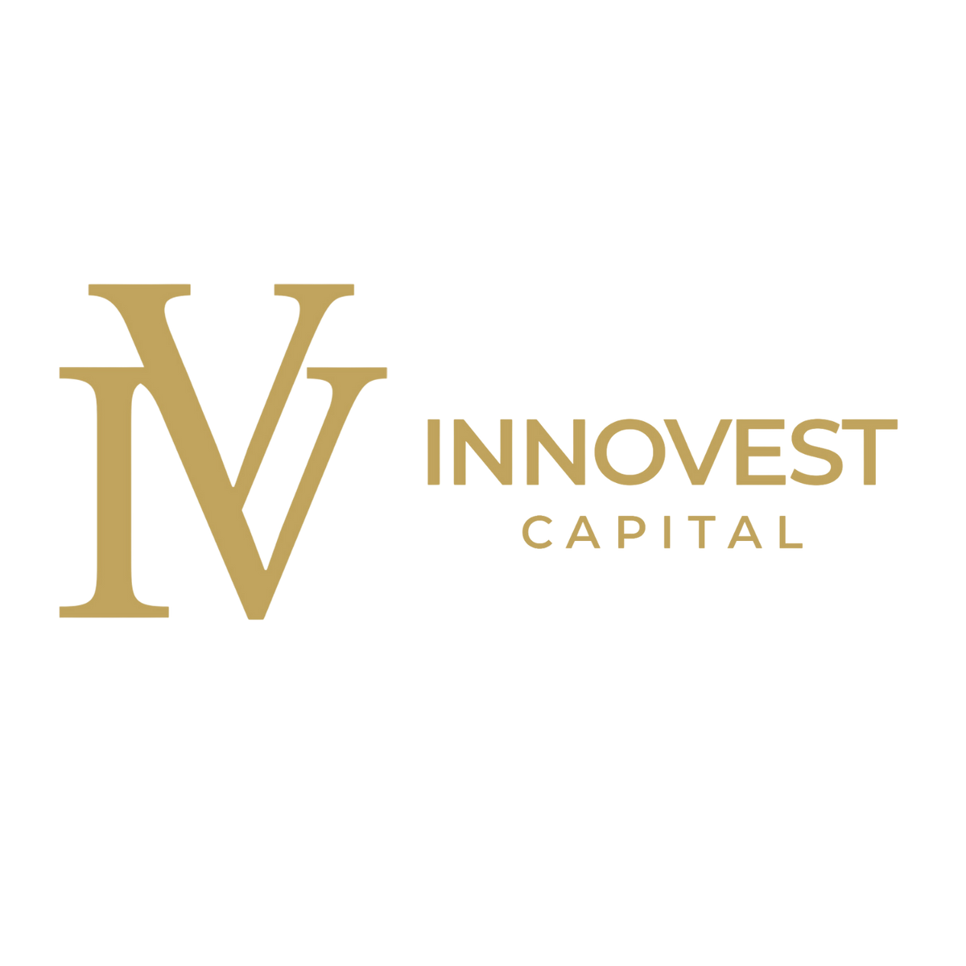
primary logo

Slide 13
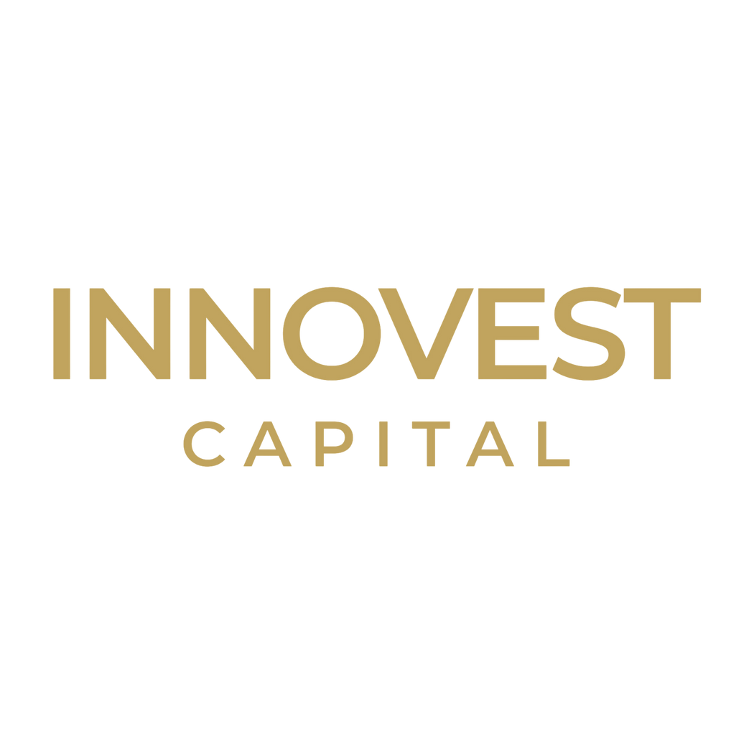
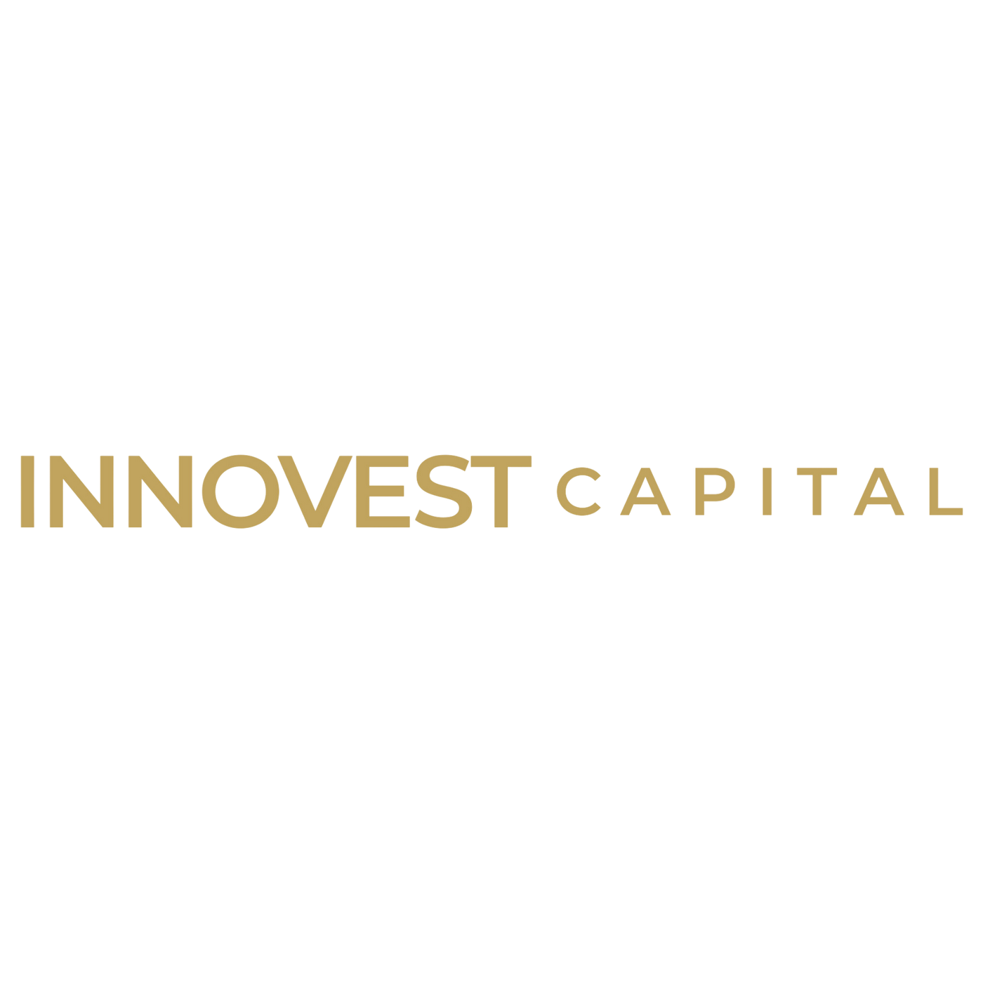
secondary logos

Slide 15
symbol

Slide 16
primary logo

Slide 17
secondary logos

Slide 19
symbol

Slide 20
secondary logos

Slide 22
symbol

